Slide 1


SEEING THE FOREST FOR THE TREES BUILDING FULLY FEATURED Hybrid MOBILE APPS
Matt Netkow
The SAVO Group
@dotNetkow
netkow.com
Notes:
Explain the title…

Slide 2











Notes:
Thanks to our Principal, Platinum and Gold Sponsors.

Slide 3
About me
Senior Developer for The SAVO Group – 5 years
Sales Productivity SaaS
Backend .NET C# development: user/document automation, tools
Mobile app development for Netkosoft – 1 year
Focus on front-end development
Entirely PhoneGap-based, Hybrid apps
Team of Two (Partnered with Graphic Designer)
Netkow.com Blog
Technology trends, programming, PhoneGap

Slide 4
Why this talk?
By 2016, > 50% of mobile apps will be hybrid.
Gartner

Slide 5



Journey to mobile app
An idea emerges…
+
=
Fitbit user
Weight Watchers member
Fitwatchr
Desired Outcome:
Challenging calorie tracking
Available for multiple platforms
Charge for the app
Fast development cycles
Results:
Initial version created in days
Available for iOS, Android, and Windows Phone 8
Price varies: from $0.99 to $2.99
Over 10,000 paying users in 1 year

Slide 6
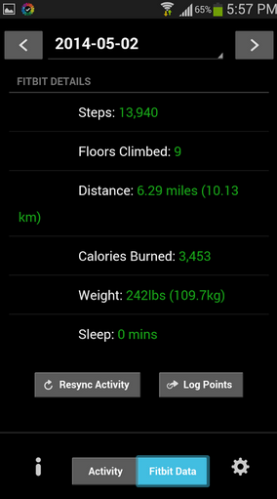
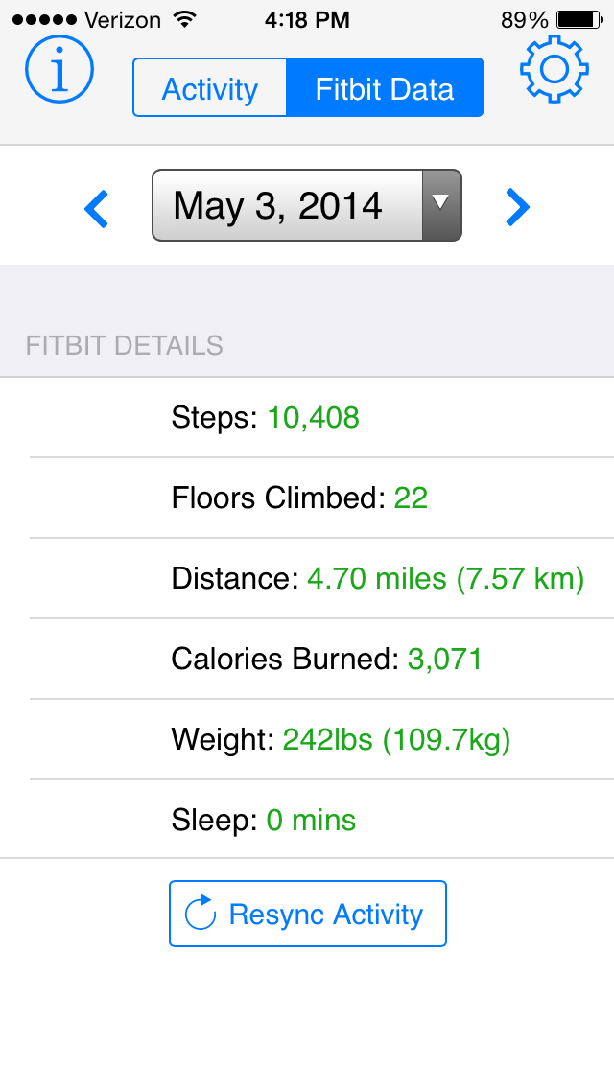
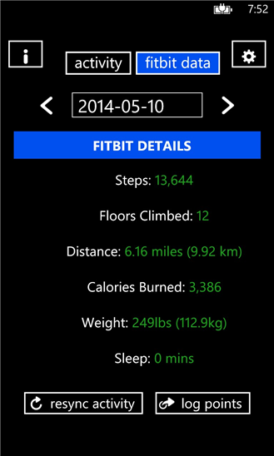
Fitwatchr versions
Android iPhone Windows Phone

Slide 7
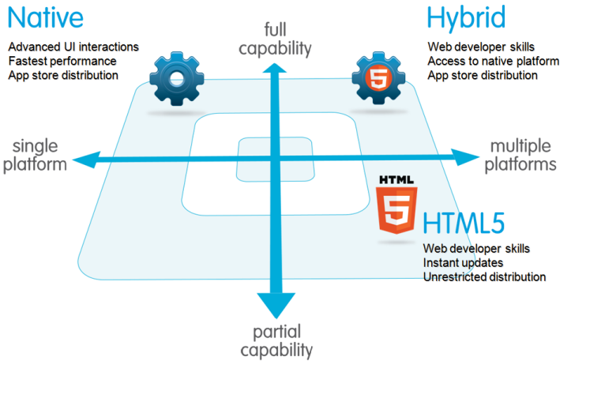
Which technology to use?
Salesforce.com
Notes:
Simpler slide. Explain image better – the axis.

Slide 8

Why Hybrid? technology
Use existing HTML5, CSS3, JavaScript knowledge
Native optional!
Full Capabilities: Device APIs
Multiple Platforms: iOS, Android, Windows Phone

Slide 9
Why hybrid? business
Lower Cost:
Single codebase
Single technology stack
Reuse business logic code*
This matters because:
BYOD trend continues to gain momentum
Mobile/remote work increasing across many industries

Slide 10
Why hybrid? individual
More opportunities: web technology usage increasing across devices
TV, cars, smartwatches
Constantly getting better: tools, frameworks, lower barrier to entry
Career: developers who are strong in both frontend & backend are desirable

Slide 11
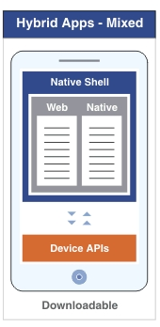
Creating a Hybrid app: Parts?
Web:
All app logic (JavaScript)
Layout (HTML)
Styling (CSS)
Native Code & Native Shell:
WebView container
Compiled app
Device APIs
IBM
Notes:
In order to create an app, we have two major parts: Web and Native.

Slide 12
Web: javascript app logic
No surprises here!
Write JS normally
Classes, libraries, unit testing
Popular Frameworks are compatible
Angular, Knockout, Backbone

Slide 13
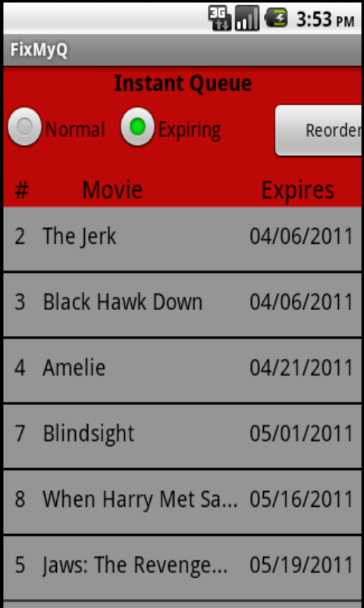
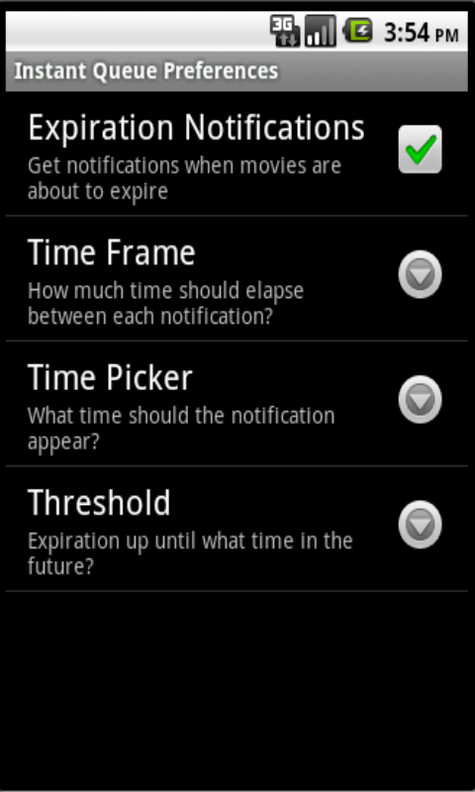
Web: layout & styling
Most developers are not good designers…
Notes:
Reference split between dev & designers.. Mobile teams smaller. More relevant than ever for devs.

Slide 14
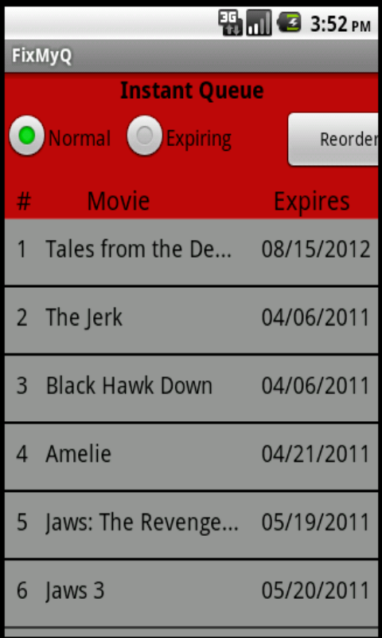
Web: layout & styling
Challenging to accomplish:
A native look
Touch friendliness
Responsiveness across
many devices
Phone:
Tablet:

Slide 15




Web: layout & styling The solution?
Let a mobile framework do the heavy lifting!
Notes:
animation

Slide 16
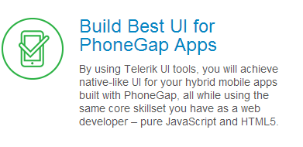
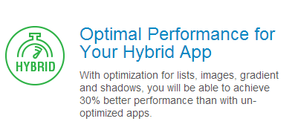

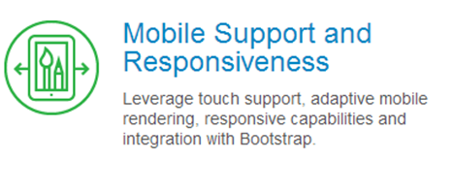
Kendo UI Mobile
KendoUI.com

Slide 17
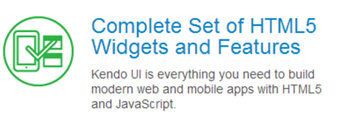
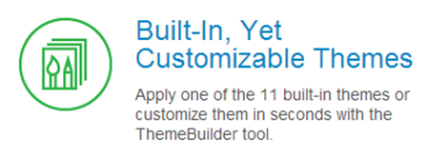

Kendo UI Framework
KendoUI.com
Demo
Notes:
KendoUI Mobile is part of the larger KendoUI framework suite

Slide 18
Responsive UI?
/* Phones */
@media only screen
and (min-device-width : 320px)
and (max-device-width : 480px) {
.img-round {
height: 40%;
width: 75%;
}
}

Slide 19
Responsive UI?
/* iPads/tablets */
@media only screen
and (min-device-width : 768px)
and (max-device-width : 1024px) {
.img-round {
height: 60%;
width: 80%;
}
}

Slide 20
Responsive UI?
/* Desktops and laptops ----------- */
@media only screen
and (min-width : 1224px) {
.img-round {
height: 20%;
width: 40%;
}
}

Slide 21
Much better!
Before:
After:

Slide 22
Kendo ui: cost?
~$700, Early 2013
$199, Late 2013
Free/open-source, April 2014
Telerik

Slide 23
From web to native app
Notes:
How do we transform our web app into a native one?

Slide 24
From web to native app
PhoneGap
Implements native “wiring” for you
Provides access to device features via JavaScript API’s
Individual Platform SDKs required
PhoneGap Build
Cloud service that creates native app & injects PhoneGap into it
No SDKs, compilers, or hardware (iOS requires a Mac)
1 private app free, unlimited open source apps

Slide 25

phonegap build: features
Plugins
Fill in missing native functionality:
Camera interaction
In-app Browser
Google Analytics
Hydration
Automatically deploy new app versions to devices
Use individually or with a team
Remote debugging
Review app code, storage, etc. all in real-time
Debug plugin behavior
demo

Slide 26
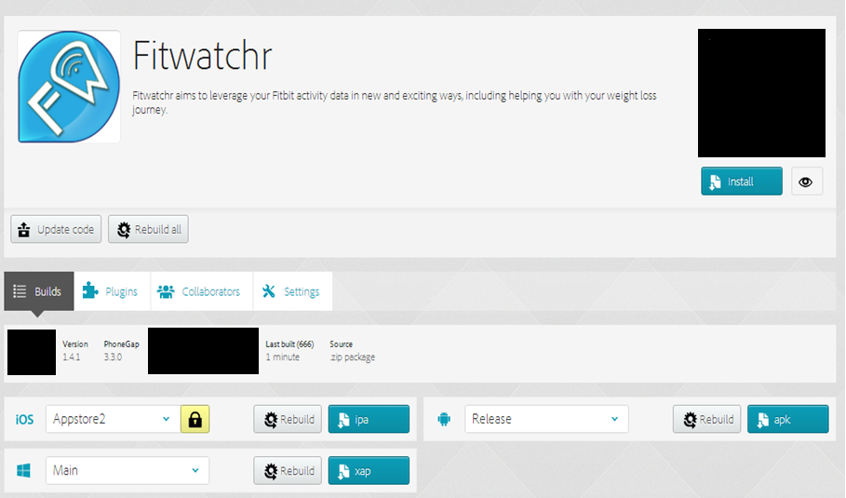
Phonegap build site
Easily build multiple versions of app from same codebase:
No Internet
Notes:
First, you zip up your code and upload it here. The Build service starts running, takes only a few minutes tops. All selected app platforms are here. You can download each compiled app here, and load it onto a device.
TODO: prep other slides like this in case of No Internet

Slide 27
Phonegap build site
No Internet

Slide 28
Creating a Hybrid app: recap
Web:
All app logic (JavaScript)
Layout (HTML)
Styling (CSS) via Kendo UI Mobile
Native & Native Shell:
Compiled app via PhoneGap Build
Device APIs: PhoneGap
Notes:
Using KendoUI Mobile, PG Build and PhoneGap we cover all the parts of a hybrid app!

Slide 29
Other popular hybrid apps
TODO!
Notes:
TODO

Slide 30
Hybrid app performance
Hardware: natural improvements over time; incredibly powerful phones now
Software:
iOS: big improvements between iOS 7 and 8 Javascript performance, 4.5x faster with new WebView; webGL adoption
Android: v4.4 has new WebView version based on Chromium
Windows Phone 8: IE10-based WebView
May never be the exact same as native - consider what is “good enough” for your app
Apple
Notes:
Nix this?

Slide 31
Key takeaways: App recommendations
Business:
Keep existing server side code for heavy processing, reusability (Xamarin, C#)
Consumer/Social/Integrations:
Short to mid-range calculations
Web APIs
Simpler Games: WebGL, Canvas
Complex Games: …Depends
Notes:
TODO: orange/red checkmarks

Slide 32
Key takeaways
Pick Hybrid!
Expand your Web development skills
Create beautiful UIs
KendoUI Mobile
Build for all devices
PhoneGap Build

Slide 33
Get building!
KendoUI source
PhoneGap Build
PhoneGap Build Starter Template
This Presentation: PPTX and code

Slide 34

Questions?
Matt Netkow
www.netkow.com
@dotNetkow
matt.netkow@gmail.com

